Slide 1
5S Presentation
Notes:
Approximately 35 - 40 minutes needed

Slide 2
What is 5S ?
5S is a simple, yet powerful tool in the
Lean Manufacturing World
The Primary Goals are:
Safety
Workplace Morale
Efficiency

Slide 3
What is 5S ?
I’m guessing you use 5S right now, but may not realize it

Slide 4
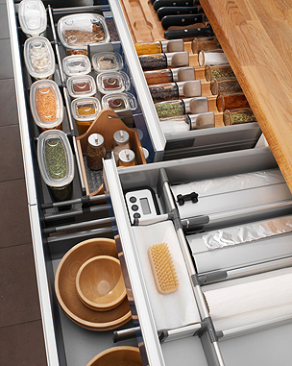
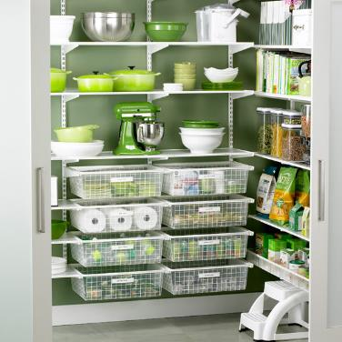
What is 5S ?
Let’s take a look at your Kitchen

Slide 5
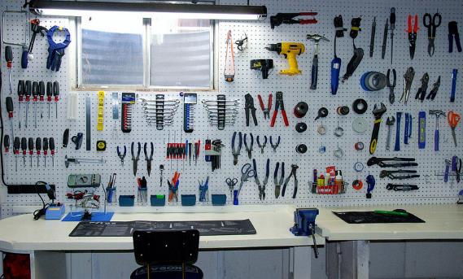
What is 5S ?
How about your Garage or Tool Room?

Slide 6
5S is a Way of Life
5S is really just plain old Common Sense
It should also be used in the Work Place…Factory Floor and Offices
The benefits of 5S include…
  A safer workplace
  Elimination of waste such as motion and transportation
  Standardization of Process
  High level of Quality
  Improvement of communication in and outside of the Team

Slide 7

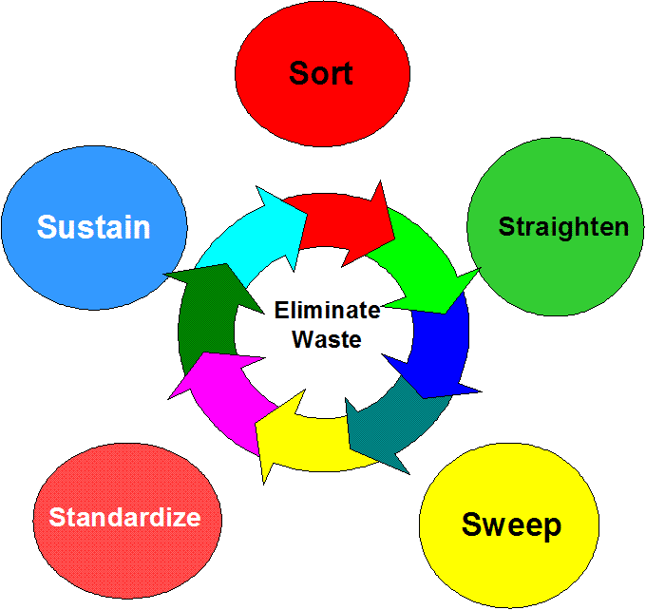


What does 5S mean?
Five words beginning with "S" used to create an efficient workplace
These are called Pillars

Slide 8
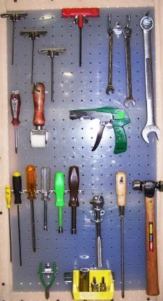
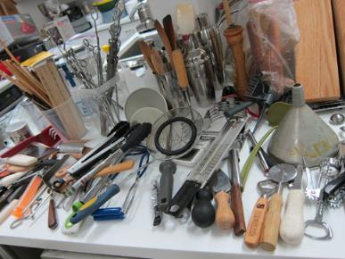
First Pillar, Sort
Sort the items in the Work Area
  Only what you need should be in the immediate area.

Slide 9

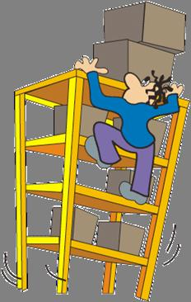
First Pillar, Sort
Sort the items in the Work Area
  Find a good place for the remaining items
  Keep the following factors in mind :
    Frequency of use
    Weight
    Size

Slide 10
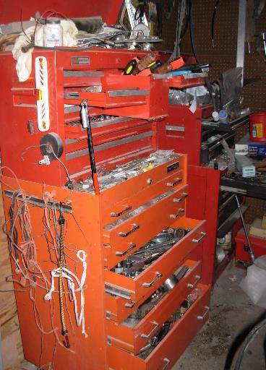
First Pillar, Sort
If you don’t Sort,
  Work area is crowded and hard to work in
  Time is wasted searching for parts or tools
“Where is that darn
Screwdriver @#$%^&” !!!!

Slide 11
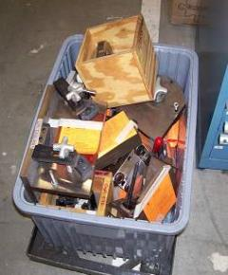
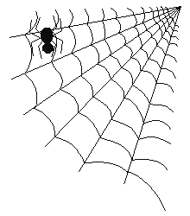

First Pillar, Sort
Examples of Unneeded Items:
  Excess quantities of small parts & inventory
  Worn out drill bits
  Broken or outdated tooling
  Old fixturing
  Empty Boxes / Containers
  Outdated posters, signs, notices, and memos
1962 Performance Chart

Slide 12

Second Pillar, Straighten – Set in Order
Evaluate and improve the efficiency of the work area
  Look for wasted movement

Slide 13
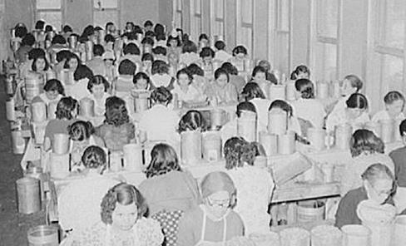
Second Pillar, Straighten – Set in Order
Evaluate and improve the efficiency of the work area
  Look for wasted movement
  Congestion

Slide 14
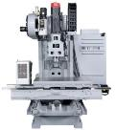


Second Pillar, Straighten – Set in Order
Evaluate and improve the efficiency of the work area
  Look for wasted movement
  Congestion
  Improper location of equipment
Too Far

Slide 15

Second Pillar, Straighten – Set in Order
Evaluate and improve the efficiency of the work area
  Look for wasted movement
  Congestion
  Improper location of equipment
  Material movement

Slide 16

Second Pillar, Straighten – Set in Order
Evaluate and improve the efficiency of the work area
  Look for wasted movement
  Congestion
  Improper location of equipment
  Material movement
  Easy Communication

Slide 17



Second Pillar, Straighten – Set in Order
Evaluate and improve the efficiency of the work area
  Look for wasted movement
  Congestion
  Improper location of equipment
  Material movement
  Easy Communication
  Access to safety equipment

Slide 18
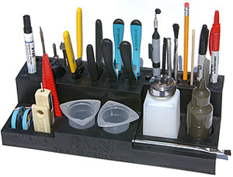
Second Pillar, Straighten – Set in Order
Arrange items so they are easy to use
Label them so anyone can find and put away

Slide 19
Second Pillar, Straighten – Set in Order
Why Set in Order?
It reduces:
  Wasted Motion – Looking for tooling, carts, and etc.
  Wasted Human Energy – Frustration when we can’t find what we are looking for
  Waste of Excess Inventory
  WIP staging areas not identified – could pick up a wrong part
  Unsafe conditions – aisle ways, exit areas are used for storage
  Before standardization can occur the workplace must be orderly

Slide 20
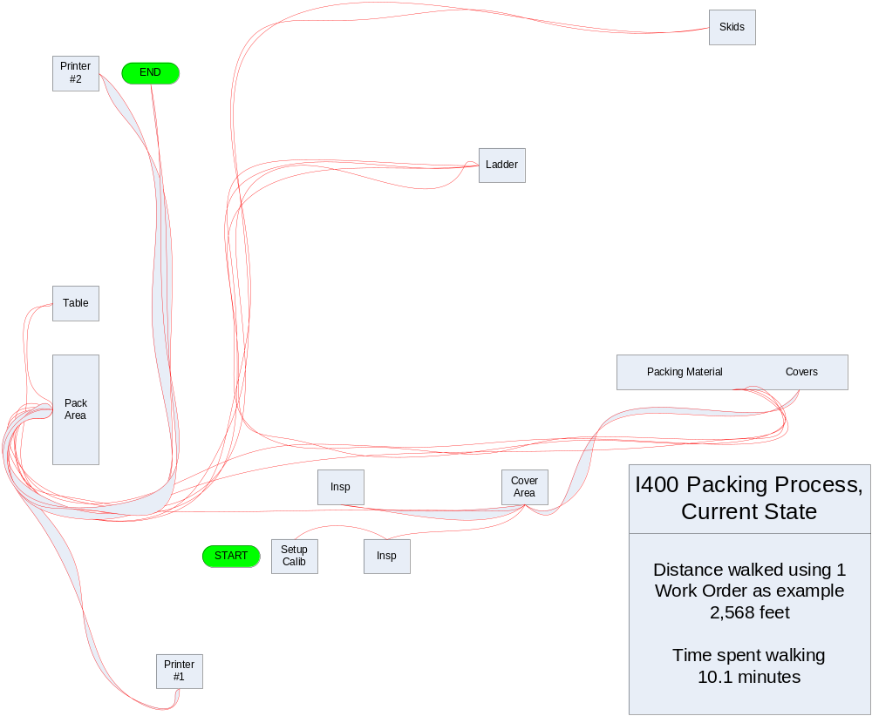
Second Pillar, Straighten – Set in Order
Spaghetti Chart
How do people and materials flow through the cell?
42 Miles Walked in 1 Year !
Before

Slide 21
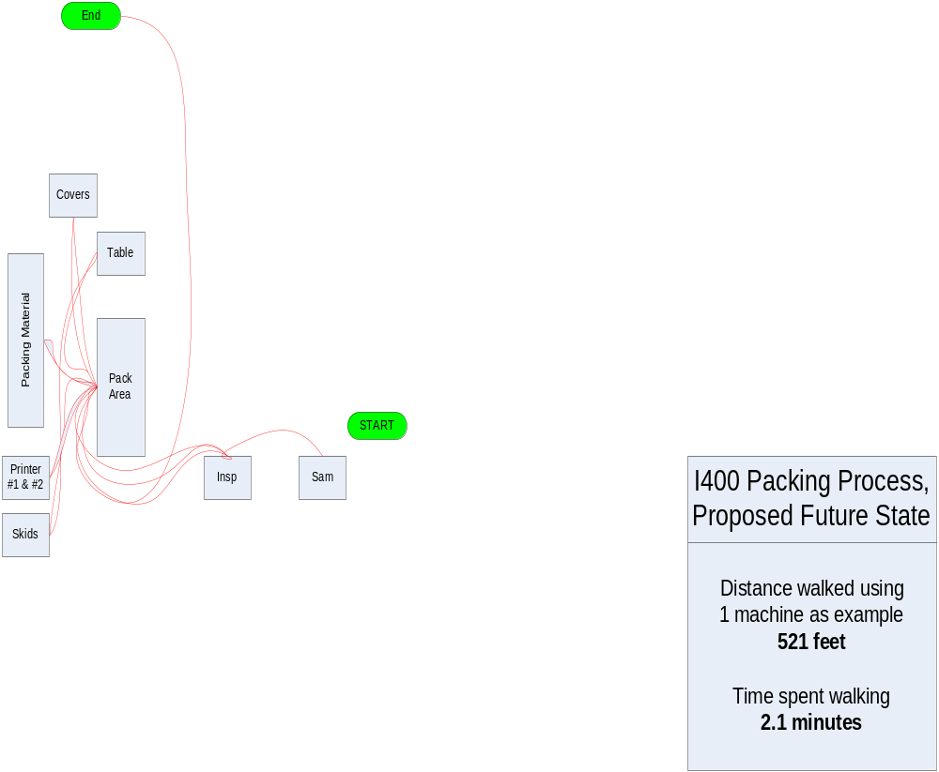
Second Pillar, Straighten – Set in Order
Down to 8 Miles in 1 Year from 42
After

Slide 22
Third Pillar, Sweep - Shine
Shine is the removal of dirt, grime, and dust from the workplace
Why Sweep & Shine?
  Better Morale - everyone appreciates a clean environment
  Keeps needed tooling & Fixturing in “Ready to Use” mode
  Allows for inspection of machinery for maintenance issues – new filters, frayed cords, min-max coolant levels, etc.
  Helps identify leaks in machinery or equipment

Slide 23
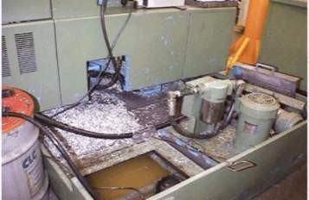
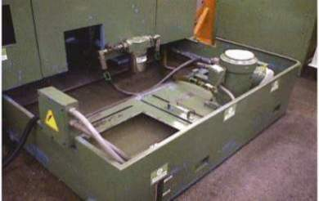
Third Pillar, Sweep - Shine
Before
After
To eliminate contamination such as dirt, chips and fluids that could cause injury or defects
Inspect equipment for signs of wear that could lead to a failure
Once clean, identify sources of the contamination and resolve

Slide 24


Fourth Pillar, Standardize
Once you have completed the Sort, Shine and Straighten sections…
  We need to Standardize
  This means make everything the same
  Sometimes people do things differently
  We need to find the best way to do it, and make that the Standard
  How can we improve anything if everyone does it differently?
Notes:
Ask the group if anyone bowls.
Everyone knows professional bowlers have practiced their approach for years. They spend their lives practicing it, because the key to winning is doing it the best way every single time.
Explain aircraft check lists
WWII saw aircraft get much more complicated. Fatal crashes occurred far more often because of the increased complexity. Pilots would forget to throw a stich, or turn on a fuel pump, or to remove the control surface lock…and people died
Checklists were created to help pilots set all the switches, flaps, gages etc. One checklist, encompassing everything, written to be user friendly, and all pilots used it without fail.
Crashes due to pilot error stopped
To this day all pilots use standardized checklists. It doesn’t matter if they’re veteran pilots, they always use them
And for those of us or our families that fly, we can thank them for that

Slide 25
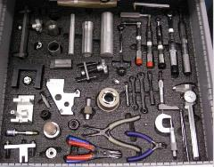
Fourth Pillar, Standardize
Standardize means everything is
The Same
  Why?
  You will automatically know where everything is if you’re working at another Work Center.
  No time wasted looking for tools, etc.
Work Center 1
Work Center 2
Work Center 3
Work Center 4
Notes:
As we get further down the path of cells, it becomes even more important.
All the tools you need will be at the work cell. Having a place for everything and everything in it’s place is critical to being productive.

Slide 26
Fifth Pillar, Sustain
This is the Hardest Part
After all the good work is done…
Keep It That Way
Difficult!

Slide 27
Fifth Pillar, Sustain
  How?
    5S must be a habit and a discipline that is followed
    Create conditions to Sustain the 5S program
    Create Awareness – do members understand the importance?
    Time – Do members have enough time in their work schedules to perform 5S?
    Structure – Do we have a structure for how and when 5S activities will be done?
    Support – Does management support the 5S efforts?
    YES!!
    Satisfaction & Excitement – Implementation of 5S can be fun and satisfying

Slide 28
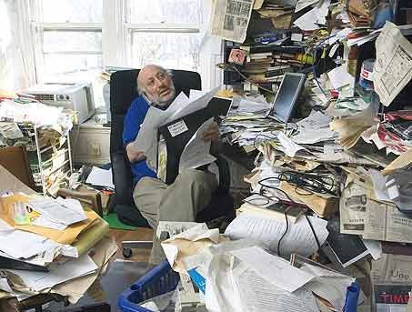
Fifth Pillar, Sustain
  Why?
  If not sustained items will start piling up
  Areas will become dirty
  A disorganized workplace
  will develop
  Back to the way it was.

Slide 29
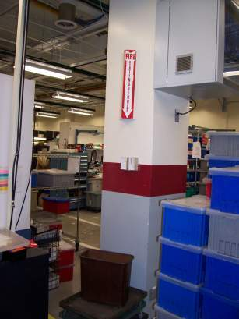
Sixth Pillar, Safety
Things to Look For
The fire extinguisher signs are in place, but the extinguishers were removed.
Let your Supervisor know

Slide 30
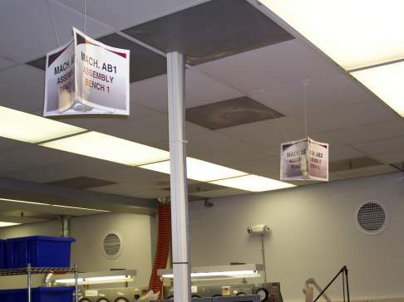
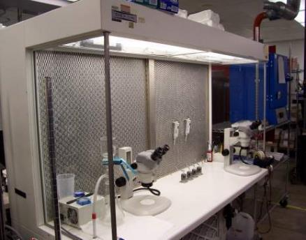
Examples
Signs
Good Lighting

Slide 31
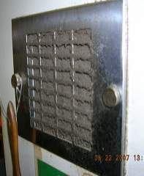
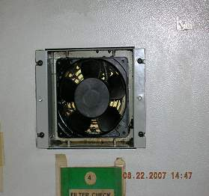
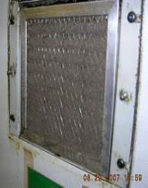
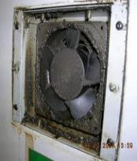
Examples
After
Before
Notes:
A dirty filter seems unimportant. But think what could, and does happen.
Air flow is reduced or stopped. The electronics in the machine overheat, and the machine goes wonky or actually goes down.
Could result in scrap and significant machine downtime for repairs

Slide 32
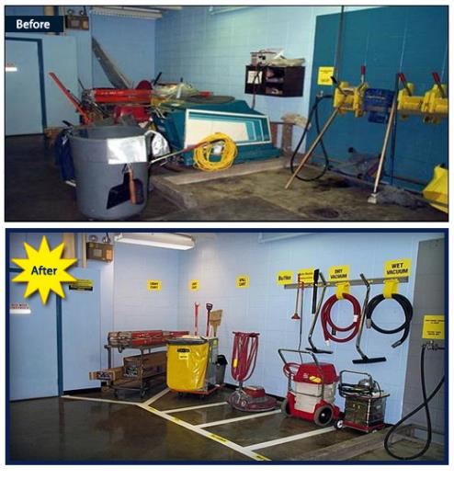
Examples

Slide 33
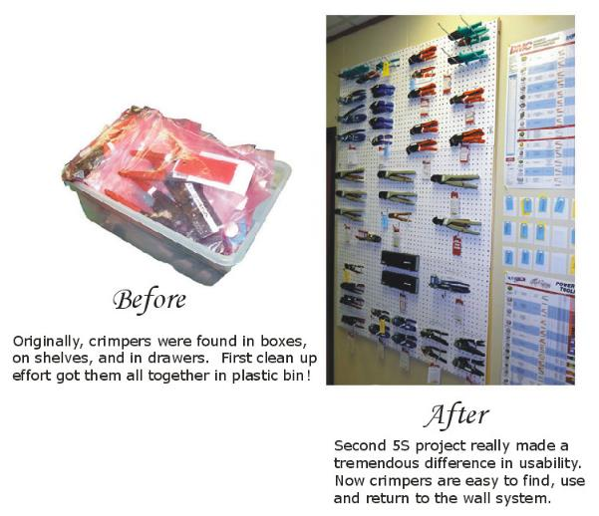
Examples

Slide 34
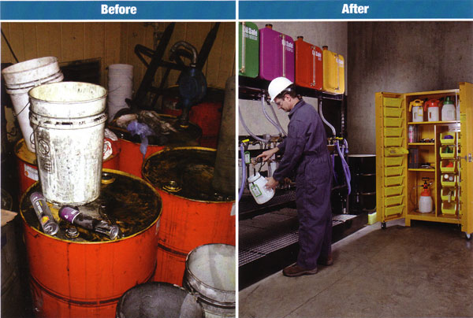
Examples

Slide 35
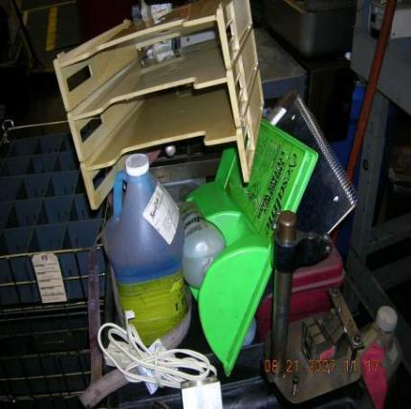
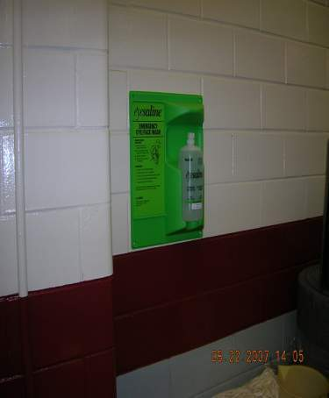
Examples
Before
After

Slide 36
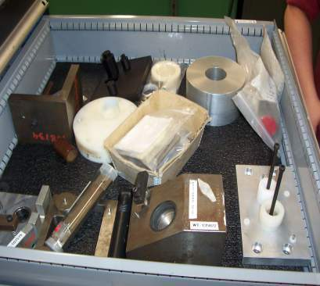
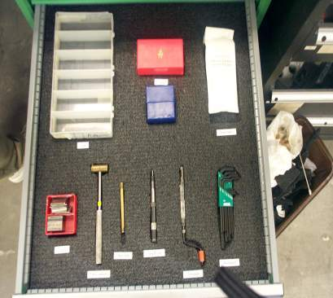
Examples
Before
After

Slide 37
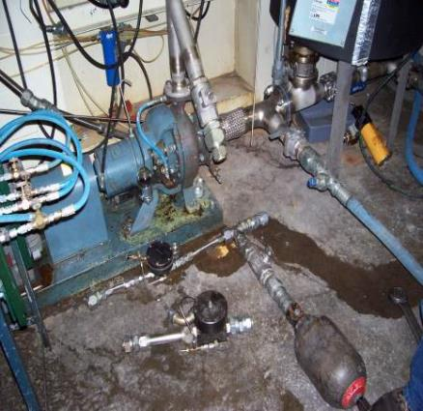
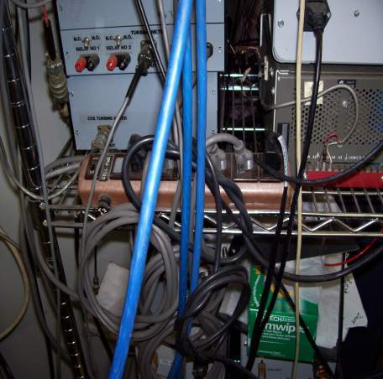
Examples

Slide 38
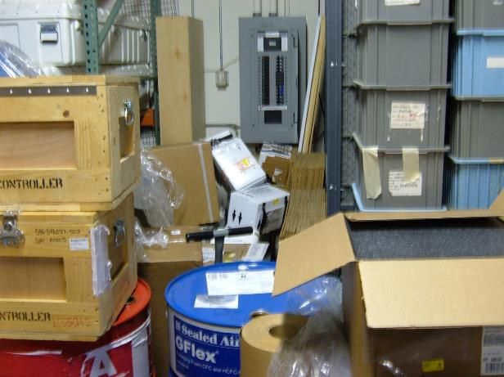
Examples

Slide 39
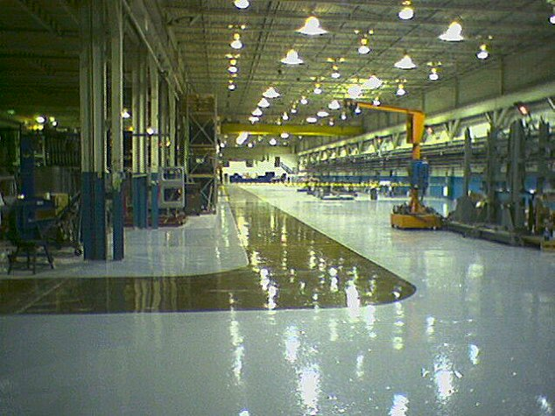
Examples

Slide 40
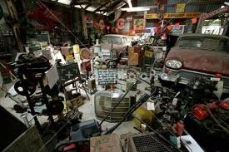
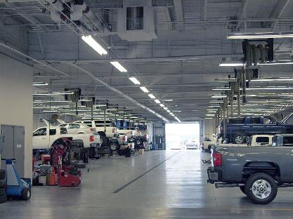
Example
Imagine your car needs servicing.
Which place would you feel better taking your car to?

Slide 41
Benefits of 5S
Don’t forget….tours of our Factory are given to Customers and potential Customers
A clean and well organized Factory inspires confidence
Customers would not be impressed with this…

Slide 42
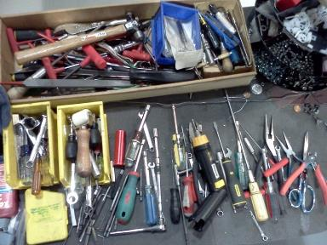
Benefits of 5S
Real Life Example
Sort Head Assembly Work Cell
Before….90 minutes to complete one Sort Head Assy
Too much walking
Too many tools, and many lost tools
Material not close by

Slide 43
Benefits of 5S
Worked with the Assembler and let them know what we were doing
Watched a build cycle
Observed all the wasted motion, walking and moved racks within reach
Arranged all the parts bins in order of use
Identified the tools needed and created a tool board
Modified the Sort Head holding fixture to eliminate the need to get down on your knees to install fasteners

Slide 44
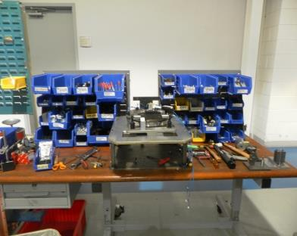
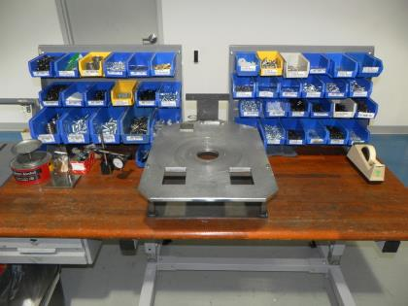
Benefits of 5S
After the improvements…
Less Clutter
Before
After
More Space
No Tool Mess

Slide 45
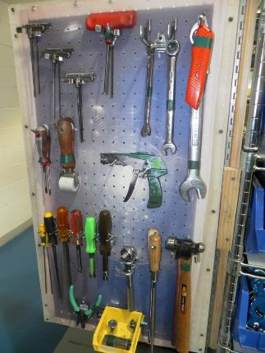
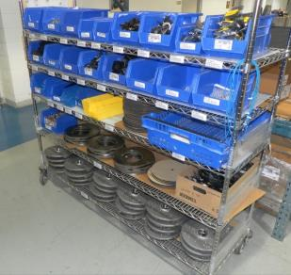
Benefits of 5S
Hundreds of feet of wasted travel eliminated
Tools are always there. They belong to the Work Center.
From 90 minutes
to 75 minutes
16.6% faster
with less effort!

Slide 46
Benefits of 5S
5S provides
  A safe workplace
  Elimination of waste such as motion and transportation
  Standardization of Process
  High level of Quality
  Improvement of communication in and outside of the Team
5S is a critical enabling component of
Lean Manufacturing

Slide 47

Creativity
Think of new ways to do things
Don’t ever say “That’s the way we’ve always done it”
Cars used to be started by hand
Most women couldn’t drive
Invented Electric Start
Notes:
Not a sexist comment, but reality. Most women did not have the strength to crank the engine over, therefore they couldn’t drive…unless someone started the car for them.

Slide 48

Creativity
Think of new ways to do things
Don’t ever say “That’s the way we’ve always done it”
No Electric Light Bulb
Candles
Whale oil lamps
Gas lights, or no lights

Slide 49
Next Steps
Areas will be 5S’d
You will be heavily involved
You are the Experts
Need your ideas and suggestions
Remember, the goal is to make things EASIER,
not harder
If it isn’t easier, we did something wrong
And remember, try something New!

Slide 50
5S Program Rollout
5S program is being done at each site
A standard checklist will be used
  It is a guide to what we need to do to achieve the 5 levels
  The checklist is also used to audit our areas / cells
Every area / cell will be audited and graded on their 5S level every month

Slide 51
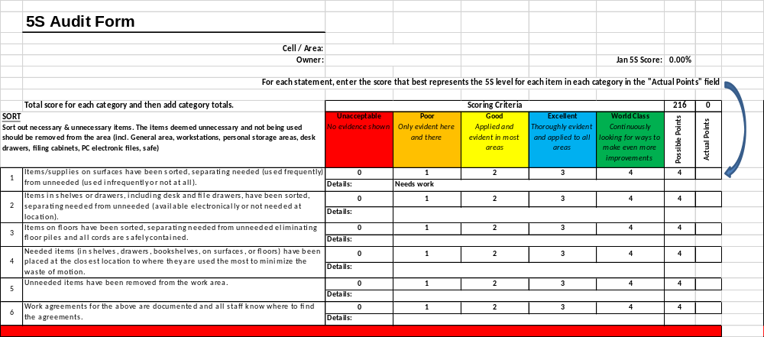
5S Program Rollout
Sample

Slide 52
5S Program Rollout
The goal is to see where we need to improve, and then do it
This is a continuous project, and will take time
It will help us achieve 5S, and make our lives easier

Slide 53
Questions
Comments

Slide 54
The 5S Numbers Game
Notes:
Approximately 15 – 20 minutes needed

Slide 55
Instruction Sheet for the Presenter
This sheet is not to be included in the presentation.
Print out X number of pages (exercises) 58, 61, 66, 59, 72, 78 and 80, where X is the number of attendees you are presenting to.
Have each of these pages grouped, and when ready, pass the first page out to each attendee, face down.
Instruct the group that they are not to turn the pages over until you say go.
Set a timer for 20 seconds. When you’re ready, tell the group to start and start your timer. Let them work on it for 20 seconds, and then tell them to stop. Pencils down.
Follow the instructions in the presentation and then pass out the second example, page 61, face down. Repeat until you are done with all examples.
Notes:
Approximately 15 – 20 minutes needed

Slide 56
Let’s have some Fun
We’re going to do an exercise to show you how powerful 5S is
What at first is an impossible task, becomes easy
Remember…this is NOT a test!
Have Fun!
Notes:
56

Slide 57
Round 1
The next slide represents our current work place.
You will see a group of numbers.
Our “job” is to cross off the numbers 1 through 49 in order. Example: 1 2 3
The “rate” for this “job” is 20 seconds.
That means we need to finish crossing off all the numbers 1 - 49
in the right order in 20 seconds or less.
Ready?
Notes:
Pass out sheets to everyone, face down, tell them NOT to turn them over until you say GO.
Make sure you hand them to the people so that when they turn them over, the blue bar is at the bottom of the page

Slide 58

48
30
87
33
45
72
3
69
27
24
51
75
21
57
18
9
6
60
78
54
36
12
63
15
81
39
66
84
42
90
2
68
53
62
29
74
77
86
80
65
5
20
56
41
23
32
44
35
89
83
8
47
50
38
11
14
59
26
17
71
54
64
49
31
61
34
28
40
16
7
58
52
10
76
22
88
73
1
85
37
82
13
4
43
25
46
19
67
79
70

Slide 59
STOP! Time’s Up!
How did everybody do?
Who got the highest number?
How did this make you feel?
Does it seem familiar?
Notes:
Equate this to not finding the tools Operators need to do their jobs

Slide 60
Round 2
To improve our process, we are going to start implementing 5S in this area.
The first “S” is “Sort”
We have removed from the area all the numbers from 50 to 90.
Why? Because they are not needed.
We only care about 1 through 49.
Now, again cross out numbers 1 to 49 in order during a 20 second shift.
Notes:
Pass sheets out again, same as before

Slide 61
48
33
45
3
30
27
21
24
18
9
6
36
12
42
15
39
29
20
5
32
41
23
35
8
44
2 11
26
38
47
17
14
49
31
7
28
16
34
40
10
22
1
4
43
25
19
37
13
46

Slide 62
STOP! Time’s Up!
How did everybody do this time?
Who got the highest number?
Was it a little easier this time?

Slide 63
Round 3
OK, we see some improvement.
We now need to implement the second 5S step, which is ”Straighten”
To do this we have installed some shelving
We organized the numbers so that number 1 is in the bottom left hand corner, the next number is on the shelf above it, the next number is above that one, then jump over to the bottom of the next column.
Like this…

Slide 64
Round 3
3
6
9
2
5
8
1
4
7
Then start back in the lower left corner and repeat.
Notes:
64

Slide 65
Round 3
Now, cross out numbers 1 to 49 in order during this 20 second shift.
Notes:
Pass sheets out again, same as before
65

Slide 66
48
33
45
3
30
27
21
24
18
9
6
36
12
42
15
39
2
29
32
41
20
5
23
44
35
8
47
38
11
26
17
14
49
31
28
16
34
7
40
10
22
1
4
43
25
19
37
13
46

Slide 67
STOP! Time’s Up!
How did everybody do this time?
Who got the highest number?
Was it a little easier this time?

Slide 68
Round 4
Now it is time to “Sweep”.
Our work area could use a little cleaning.
We “cleaned up” the area to get rid of the clutter.
Just like before, cross out numbers 1 to 49 in order during the 20 second shift.
Notes:
Pass sheets out again, same as before

Slide 69
48
33
45
3
30
27
21
24
18
9
6
36
12
42
15
39
2
29
32
41
20
5
23
44
35
8
47
38
11
26
17
14
49
31
28
16
34
7
40
10
22
1
4
43
25
46
19
37
13

Slide 70
STOP! Time’s Up!
Getting better all the time
Who got the highest number?
Was it a little easier this time?

Slide 71
Round 5
The process has again been improved and we will now implement the fourth “S” – “Standardize”.
Since we are working with numbers 1 to 49 in order, it seems logical to organize them in a way that makes doing the work as easy as possible.
This should ensure that everyone is able to complete the task in the most efficient manner possible.
One more time, cross out numbers 1 to 49 in order during the 20 second shift.
Notes:
Pass sheets out again, same as before

Slide 72
2
4
7
8
10
1
3
5
6
9
16
20
11
15
17
18
19
12
13
14
21
22
23
24
25
26
27
28
30
29
32
31
33
36
37
34
38
39
40
35
41
42
43
44
45
47
48
49
46

Slide 73
STOP! Time’s Up!
Excellent!
How was that?
It doesn’t get much easier than this.

Slide 74
Round 6
When we first started this exercise, 20 seconds to finish the job was impossible.
But with simple 5S methods, we are able to beat the 20 seconds with ease.
Notes:
74

Slide 75
Round 6
Did we work any harder?
No
Did your frustration go away?
Yes
Does this make our work easier?
Yes
Did we have to buy a lot of expensive equipment?
No
Notes:
75

Slide 76
Round 6
5S is a simple yet very powerful way to implement visual management and improve productivity

Slide 77
Round 6
Let’s go back to our original work area, before our 5S effort
We find that we have two missing numbers
We cannot complete our job without these numbers, so first we have to find them.
Ready?
Notes:
Pass sheets out again, same as before
Every 20 seconds, tell the members how many “shifts” they have been looking for the missing numbers.
77

Slide 78
48
30
87
33
45
72
3
69
27
24
51
75
21
57
9
6
60
78
54
36
12
63
15
81
39
66
84
90
2
68
53
62
29
74
77
86
80
65
5
20
56
41
23
32
44
35
89
83
8
47
50
38
11
14
59
26
17
71
54
64
49
31
61
34
28
40
16
7
58
52
10
76
22
88
73
1
85
37
82
13
4
43
25
46
19
67
79
70

Slide 79
Unorganized work areas make this very difficult!
Let’s try this again AFTER we put 5S back in place.
Which two numbers are missing?
Notes:
Pass sheets out again, same as before

Slide 80
2
4
7
8
10
1
3
5
6
9
16
20
11
15
17
19
12
13
14
21
22
23
24
25
26
27
28
30
29
32
31
33
36
37
34
35
38
39
40
41
47
43
44
45
48
49
46

Slide 81
Benefits
You can see how much easier an organized workplace makes your job
Large amounts of Waste can be eliminated when we implement 5S
This is why 5S is called the cornerstone of Lean

Slide 82

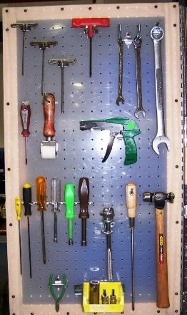
Benefits
Before
After
Just like our Number Game
Notes:
82

Slide 83
Benefits
How can we use this in our Work Place?
    At Workstations
    At Machines
    At Desks
    In Offices
    Home
    Everywhere!

Slide 84
Benefits
The faster and better we can build, the less it costs us
We win more orders because we can build faster and cheaper than our competition
We might reduce our prices, which means even more business
The goal is to make our jobs easier, not harder

Slide 85
Conclusion
Thanks for participating!!
Questions
Comments
Thoughts

